Slide 1
Source : These slides are taken from bootlin.com
Bootloaders
1/532

Slide 2
Boot Sequence

Slide 3
What is bootloader
The bootloader is a piece of code responsible for
Basic hardware initialization
Loading of an application binary, usually an operating system kernel, from flash storage, from the network, or from another type of non-volatile storage.
Possibly decompression of the application binary
Execution of the application
Besides these basic functions, most bootloaders provide a shell with various commands implementing different operations.
Loading of data from storage or network, memory inspection, hardware diagnostics and testing, etc.

Slide 4
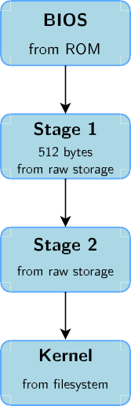
Bootloaders on BIOS-based x86 (1)
The x86 processors are typically bundled on a board with a non-volatile memory containing a program, the BIOS.
On old BIOS-based x86 platforms: the BIOS is responsible for basic hardware initialization and loading of a very small piece of code from non-volatile storage.
This piece of code is typically a 1st stage bootloader, which will load the full bootloader itself.
It typically understands filesystem formats so that the kernel file can be loaded directly from a normal filesystem.
This sequence is different for modern EFI-based systems.

Slide 5
Bootloaders on x86 (2)
GRUB, Grand Unified Bootloader, the most powerful one.
https://www.gnu.org/software/grub/
Can read many filesystem formats to load the kernel image and the configuration, provides a powerful shell with various commands, can load kernel images over the network, etc.
Syslinux, for network and removable media booting (USB key, CD-ROM)
https://kernel.org/pub/linux/utils/boot/syslinux/
Systemd-boot, a very simple UEFI boot manager (formerly Gumniboot)
Of course, not based on Systemd, but hosted by this project.

Slide 6
Booting on embedded CPUs: case 1
When powered, the CPU starts executing code at a fixed address
There is no other booting mechanism provided by the CPU
The hardware design must ensure that a NOR flash chip is wired so that it is accessible at the address at which the CPU starts executing instructions
The first stage bootloader must be programmed at this address in the NOR
NOR is mandatory, because it allows direct access from the CPU (just like RAM), which NAND doesn’t allow (external storage that needs to be copied to RAM before executing).
Not very common anymore (unpractical, and requires NOR flash)

Slide 7
Booting on embedded CPUs: case 2
The CPU has an integrated boot code in ROM
BootROM on AT91 CPUs, “ROM code” on OMAP, etc.
Exact details are CPU-dependent
This boot code is able to load a first stage bootloader from a storage device into an internal SRAM (DRAM not initialized yet)
Storage device can typically be: MMC, NAND, SPI flash, UART (transmitting data over the serial line), etc.
The first stage bootloader is
Limited in size due to hardware constraints (SRAM size)
Provided either by U-Boot (called Secondary Program Loader - SPL), or by the CPU vendor (usually open-source).
This first stage bootloader must initialize DRAM and other hardware devices and load a second stage bootloader into DRAM

Slide 8
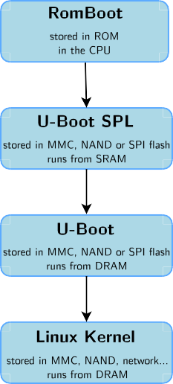
Booting on Microchip ARM SAMA5D3
RomBoot: tries to find a valid bootstrap image from various storage sources, and load it into SRAM (DRAM not initialized yet). Size limited to 64 KB. No user interaction possible in standard boot mode.
U-Boot SPL: runs from SRAM. Initializes the DRAM, the NAND or SPI controller, and loads the secondary bootloader into DRAM and starts it. No user interaction possible.
U-Boot: runs from DRAM. Initializes some other hardware devices (network, USB, etc.). Loads the kernel image from storage or network to DRAM and starts it. Shell with commands provided.
Linux Kernel: runs from DRAM. Takes over the system completely (the bootloader no longer exists).
Note: same process on other Microchip AT91 SoCs, but the SRAM size is smaller on the older ones.

Slide 9
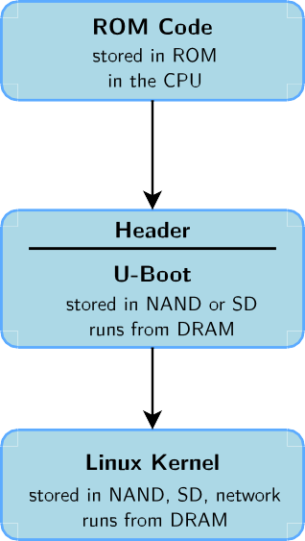
Booting on Marvell SoCs
ROM Code: tries to find a valid bootstrap image from various storage sources, and load it into DRAM. The DRAM configuration is described in a CPU-specific header, prepended to the bootloader image.
U-Boot: runs from DRAM. Initializes some other hardware devices (network, USB, etc.). Loads the kernel image from storage or network to DRAM and starts it. Shell with commands provided. File called u-boot.kwb.
Linux Kernel: runs from DRAM. Takes over the system completely (bootloaders no longer exists).

Slide 10
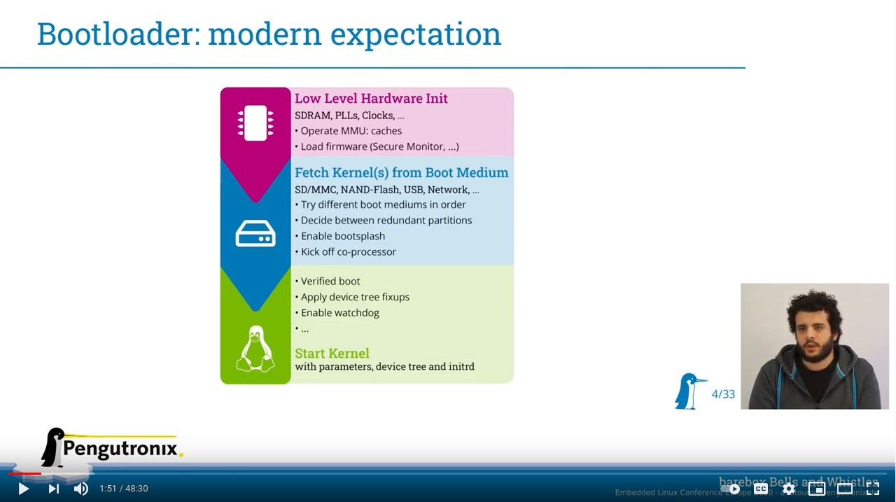
Generic bootloaders for embedded CPUs
There are several open-source generic bootloaders. Here are the most popular ones:
U-Boot, the universal bootloader by Denx
The most used on ARM, also used on PPC, MIPS, x86, m68k, RISC-V, etc.
The de-facto standard nowadays. We will study it in detail.
https://www.denx.de/wiki/U-Boot
Barebox, an architecture-neutral bootloader created by Pengutronix.
It doesn’t have as much hardware support as U-Boot yet.
U-Boot has improved quite a lot thanks to this competitor.
https://www.barebox.org
See the nice introduction to Barebox from Ahmad Fatoum at ELCE 2020:
Video: https://youtu.be/Oj7lKbFtyM0
Slides: https://elinux.org/images/9/9d/Barebox-bells- n-whistles.pdf

Slide 11
The U-boot bootloader
Bootloaders

Slide 12



U-Boot
U-Boot is a typical free software project
License: GPLv2 (same as Linux)
Freely available at https://www.denx.de/wiki/U-Boot
Documentation available at
https://u-boot.readthedocs.io/en/latest/
The latest development source code is available in a Git repository: https://gitlab.denx.de/u-boot/u-boot
Development and discussions happen around an open mailing-list
https://lists.denx.de/pipermail/u-boot/
Follows a regular release schedule. Every 2 or 3 months, a new version is released. Versions are named YYYY.MM.
Image credits:
https://frama.link/rwCUFc-T

Slide 13
U-Boot configuration
Get the source code from the website or from git
The configs/ directory contains one or several configuration file(s) for each supported board
It defines the CPU type, the peripherals and their configuration, the memory mapping, the U-Boot features that should be compiled in, etc.
Examples: configs/stm32mp15_basic_defconfig configs/stm32mp15_trusted_defconfig
Note: U-Boot is migrating from board configuration defined in C header files (include/configs/) to defconfig like in the Linux kernel (configs/)
Not all boards have been converted to the new configuration system.
Many boards still have both hardcoded configuration settings in .h files, and configuration settings in defconfig files that can be overriden with configuration interfaces.

Slide 14
U-Boot configuration file
CHIP_defconfig
CONFIG_ARM=y CONFIG_ARCH_SUNXI=y CONFIG_MACH_SUN5I=y
CONFIG_DRAM_TIMINGS_DDR3_800E_1066G_1333J=y
# CONFIG_MMC is not set CONFIG_USB0_VBUS_PIN="PB10" CONFIG_VIDEO_COMPOSITE=y CONFIG_DEFAULT_DEVICE_TREE="sun5i-r8-chip" CONFIG_SPL=y CONFIG_SYS_EXTRA_OPTIONS="CONS_INDEX=2"
# CONFIG_CMD_IMLS is not set
CONFIG_CMD_DFU=y CONFIG_CMD_USB_MASS_STORAGE=y CONFIG_AXP_ALDO3_VOLT=3300 CONFIG_AXP_ALDO4_VOLT=3300 CONFIG_USB_MUSB_GADGET=y CONFIG_USB_GADGET=y CONFIG_USB_GADGET_DOWNLOAD=y
CONFIG_G_DNL_MANUFACTURER="Allwinner Technology"
CONFIG_G_DNL_VENDOR_NUM=0x1f3a CONFIG_G_DNL_PRODUCT_NUM=0x1010 CONFIG_USB_EHCI_HCD=y

Slide 15
Configuring and compiling U-Boot
U-Boot must be configured before being compiled
Configuration stored in a .config file
make BOARDNAME_defconfig
Where BOARDNAME is the name of a configuration, as visible in the configs/
directory.
You can then run make menuconfig to further customize U-Boot’s configuration!
Make sure that the cross-compiler is available in PATH
Compile U-Boot, by specifying the cross-compiler prefix. Example, if your cross-compiler executable is arm-linux-gcc: make CROSS_COMPILE=arm-linux-
The main result is a u-boot.bin file, which is the U-Boot image. Depending on your specific platform, or what storage device you’re booting from (NAND or MMC), there may be other specialized images: u-boot.img, u-boot.kwb...
This also generates the U-Boot SPL image to be flashed together with U-Boot. The exact file name can vary too, depending on what the romcode expects.

Slide 16
Installing U-Boot
U-Boot must usually be installed in flash memory to be executed by the hardware. Depending on the hardware, the installation of U-Boot is done in a different way:
The CPU provides some kind of specific boot monitor with which you can communicate through the serial port or USB using a specific protocol
The CPU boots first on removable media (MMC) before booting from fixed media (NAND). In this case, boot from MMC to reflash a new version
U-Boot is already installed, and can be used to flash a new version of U-Boot. However, be careful: if the new version of U-Boot doesn’t work, the board is unusable
The board provides a JTAG interface, which allows to write to the flash memory remotely, without any system running on the board. It also allows to rescue a board if the bootloader doesn’t work.

Slide 17
U-boot prompt
Connect the target to the host through a serial console.
Power-up the board. On the serial console, you will see something like:
U-Boot 2020.04 (May 26 2020 - 16:05:43 +0200)
CPU: SAMA5D36
Crystal frequency: CPU clock :
Master clock :
DRAM: 256 MiB
NAND: 256 MiB
12 MHz
528 MHz
132 MHz
MMC: Atmel mci: 0, Atmel mci: 1 Loading Environment from NAND... OK In: serial@ffffee00
Out: serial@ffffee00
Err: serial@ffffee00
Net: eth0: ethernet@f0028000
Error: ethernet@f802c000 address not set.
Hit any key to stop autoboot: 0
=>
The U-Boot shell offers a set of commands. We will study the most important ones, see the documentation for a complete reference or the help command.

Slide 18
Information commands
Version details
=> version
U-Boot 2020.04 (May 26 2020 - 16:05:43 +0200)
arm-linux-gcc (crosstool-NG 1.24.0.105_5659366) 9.2.0 GNU ld (crosstool-NG 1.24.0.105_5659366) 2.34
NAND flash information
=> nand info
Device 0: nand0, sector size 128 KiB
Page size OOB size Erase size subpagesize options
2048 b
64 b
131072 b
2048 b
0x40004200
bbt options 0x00008000

Slide 19
Important commands (1)
The exact set of commands depends on the U-Boot configuration
help and help command
fatload, loads a file from a FAT filesystem to RAM
Example: fatload usb 0:1 0x21000000 zImage
And also fatinfo, fatls, fatsize, fatwrite...
Similar commands for other filesystems: ext2load, ext2ls, ext4load, ext4ls, sqfsload, sqfsls... (SquashFS support contributed by Bootlin)
Note that filesystem independent commands such as load, ls, and size exist. Examples:
load usb 0:1 0x21000000 zImage
ls mmc 0:2 boot/
size mmc 0:1 dtb (result stored in filesize environment variable)
loadb, loads, loady, load a file from the serial line to RAM
tftp, loads a file from the network to RAM (example given later)

Slide 20
Important commands (2)
ping, to test the network
bootd (can be abbreviated as boot), runs the default boot command, stored in the bootcmd environment variable (explained later)
bootz <address>, starts a compressed kernel image loaded at the given address in RAM
usb, to initialize and control the USB subsystem, mainly used for USB storage devices such as USB keys
mmc, to initialize and control the MMC subsystem, used for SD and microSD cards
nand, to erase, read and write contents to NAND flash
md, displays memory contents. Can be useful to check the contents loaded in memory, or to look at hardware registers.
mm, modifies memory contents. Can be useful to modify directly hardware registers, for testing purposes.

Slide 21
U-Boot bdinfo command
=> bdinfo
arch_number = 0x00000000 boot_params = 0x20000100
DRAM bank
-> start
-> size baudrate TLB addr relocaddr reloc off irq_sp
sp start
= 0x00000000
= 0x20000000
= 0x10000000
= 115200 bps
= 0x2FFF0000
= 0x2FF27000
= 0x09027000
= 0x2FB1DC40
= 0x2FB1DC30
Allow to ﬁnd valid RAM addresses without needing the SoC datasheet or board manual
Early malloc usage: 135c / 2000
fdt_blob = 2fb1dc50
Source: U-Boot 2018.01
on Microchip SAMA5D3 Xplained

Slide 22
Environment variables: principle
U-Boot can be configured through environment variables
Some specific environment variables impact the behavior of the different commands
Custom environment variables can be added, and used in scripts
Environment variables are loaded from persistent storage to RAM at U-Boot startup. They can be defined or modified and saved back to storage for persistence.

Slide 23
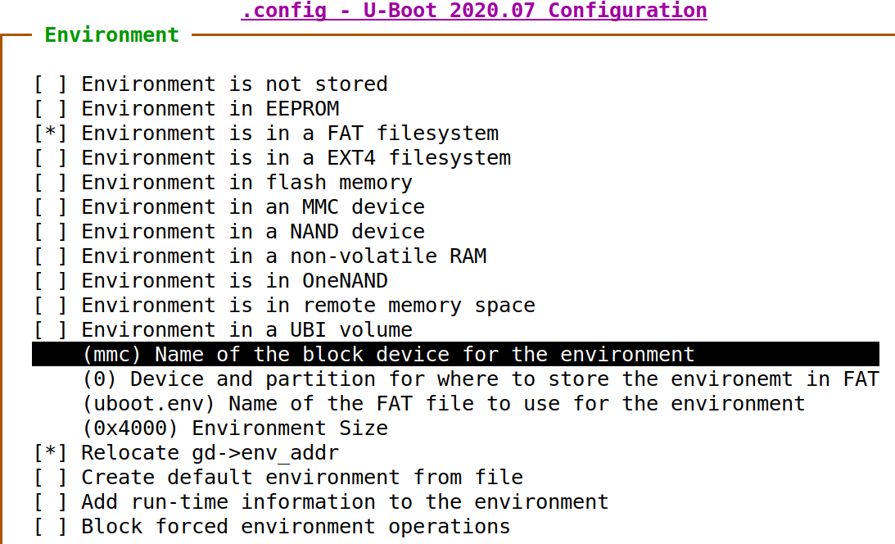
Environment variables: implementation
Depending on the configuration, the
U-Boot environment is typically stored in:
At a fixed offset in NAND flash
At a fixed offset on MMC or USB storage, before the beginning of the first partition.
In a file (uboot.env) on a FAT or ext4 partition
In a UBI volume
U-Boot environment configuration menu

Slide 24
Environment variables commands
Commands to manipulate environment variables:
printenv
Shows all variables
printenv <variable-name>
Shows the value of a variable
setenv <variable-name> <variable-value>
Changes the value of a variable or defines a new one, only in RAM
editenv <variable-name>
Edits the value of a variable in-place, only in RAM
saveenv
Saves the current state of the environment to storage for persistence.

Slide 25
Environment variables commands - Example
=> printenv baudrate=19200 ethaddr=00:40:95:36:35:33
netmask=255.255.255.0 ipaddr=10.0.0.11 serverip=10.0.0.1 stdin=serial stdout=serial stderr=serial
=> setenv serverip 10.0.0.100
=> printenv serverip serverip=10.0.0.100
=> saveenv

Slide 26
Important U-Boot env variables
bootcmd, specifies the commands that U-Boot will automatically execute at boot time after a configurable delay (bootdelay), if the process is not interrupted. See next page for an example.
bootargs, contains the arguments passed to the Linux kernel, covered later
serverip, the IP address of the server that U-Boot will contact for network related commands
ipaddr, the IP address that U-Boot will use
netmask, the network mask to contact the server
ethaddr, the MAC address, can only be set once
filesize, the size of the latest copy to memory (from tftp, fatload, nand read...)

Slide 27
Scripts in environment variables
Environment variables can contain small scripts, to execute several commands and test the results of commands.
Useful to automate booting or upgrade processes
Several commands can be chained using the ; operator
Tests can be done using if command ; then ... ; else ... ; fi
Scripts are executed using run <variable-name>
You can reference other variables using ${variable-name}
Examples
setenv bootcmd 'tftp 0x21000000 zImage; tftp 0x22000000 dtb; bootz 0x21000000 - 0x22000000'
setenv mmc-boot 'if fatload mmc 0 80000000 boot.ini; then source; else if fatload mmc 0 80000000 zImage; then run mmc-do-boot; fi; fi'

Slide 28
Transferring files to the target
U-Boot is mostly used to load and boot a kernel image, but it also allows to change the kernel image and the root filesystem stored in flash.
Files must be exchanged between the target and the development workstation. This is possible:
Through the network (Ethernet if a network port is available, Ethernet over USB device...), if U-Boot has drivers for such networking. This is the fastest and most efficient solution.
Through a USB key, if U-Boot supports the USB controller of your platform
Through a SD or microSD card, if U-Boot supports the MMC controller of your platform
Through the serial port (loadb, loadx or loady command)

Slide 29
TFTP
Network transfer from the development workstation to U-Boot on the target takes place through TFTP
Trivial File Transfer Protocol
Somewhat similar to FTP, but without authentication and over UDP
A TFTP server is needed on the development workstation
sudo apt install tftpd-hpa
All files in /var/lib/tftpboot or in /srv/tftp (if /srv exists) are then visible through TFTP
A TFTP client is available in the tftp-hpa package, for testing
A TFTP client is integrated into U-Boot
Configure the ipaddr, serverip, and ethaddr environment variables
Use tftp <address> <filename> to load file contents to the specified RAM address
Example: tftp 0x21000000 zImage

